Slide 1

WARM UP
Work in group of four. In five minutes, list many words as possible about house. Which team list the most word is the winner.
MY HOUSE

Slide 2

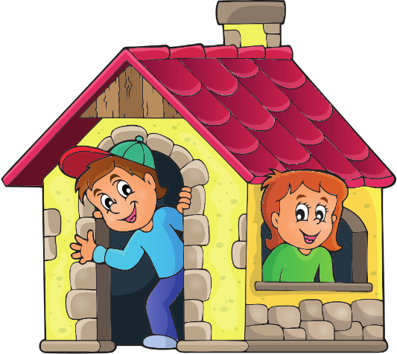

UNIT 1
MY HOME

Slide 3
NEW WORDS

Slide 4

apartment (n)
/əˈpɑːtmənt/
căn hộ (chung cư)
She lives in a big apartment.
(Cô ấy sống ở một căn hộ lớn.)

Slide 5
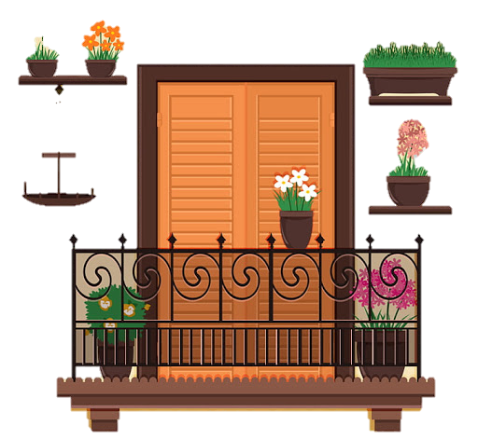
balcony (n)
/ˈbælkəni/
ban công
My apartment has a beautiful balcony.
(Căn hộ của tôi có 1 ban công rất đẹp.)

Slide 6

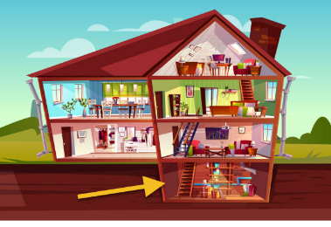

basement (n)
/ˈbeɪsmənt/
tầng hầm
My house has a basement
(Nhà của tôi có 1 tầng hầm.)

Slide 7
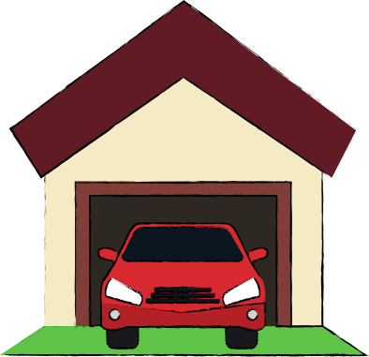
garage (n)
/ˈgærɑːʒ/
gara/ nhà để xe
Do you put your car in the garage?
(Bạn có để ô tô của bạn trong ga-ra không?)

Slide 8
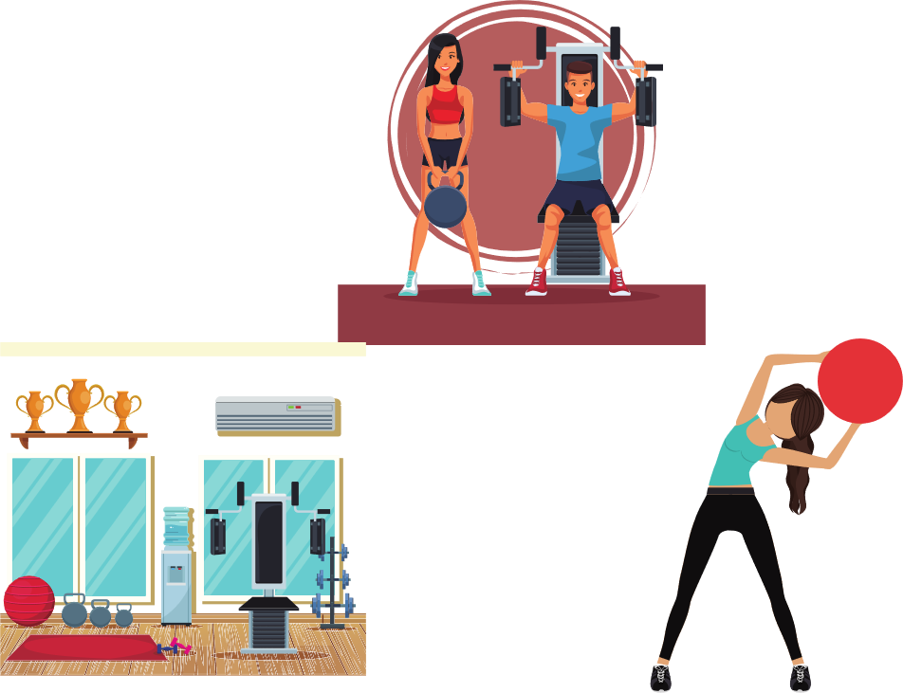
gym (n)
/ʤɪm/
phòng tập thể dục
My sister goes to the gym twice a week.
(Chị gái tôi thường đến phòng tập 2 lần 1 tuần.)

Slide 9
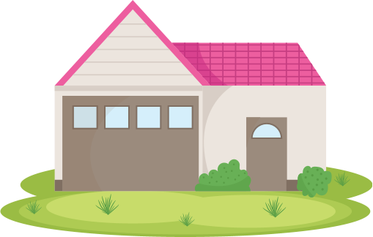
yard (n)
/jɑːd/
cái sân
My grandparents’ house has a big yard.
(Nhà của ông bà tôi có 1 cái sân to.)

Slide 10

pool (n)
/puːl/
bể bơi
There is a swimming pool behind his house
Có một bể bơi phía sau nhà của anh ấy.

Slide 11
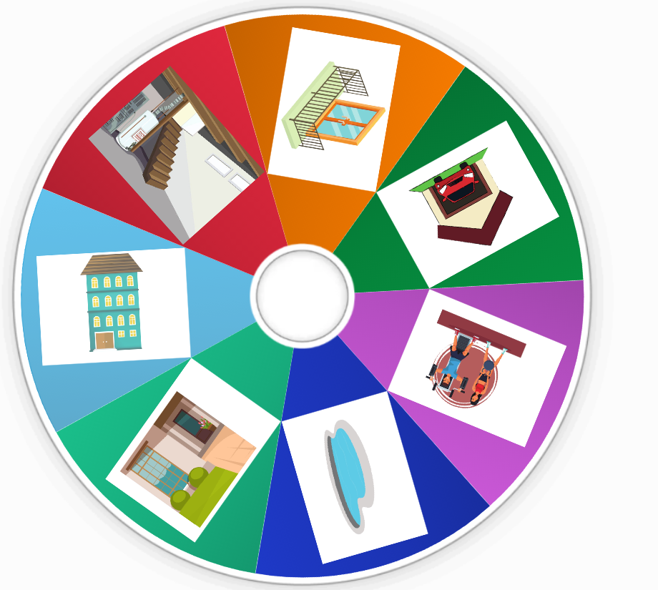

https://wordwall.net/resource/19494623
Click here

Slide 12


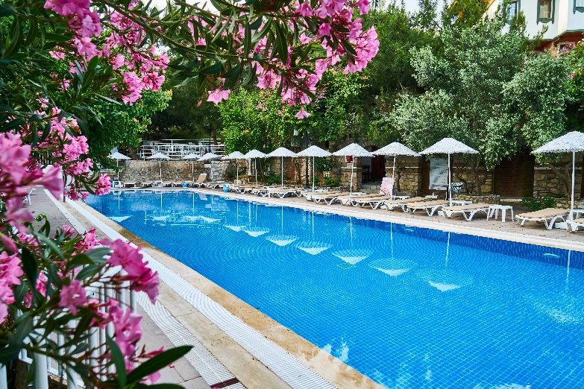
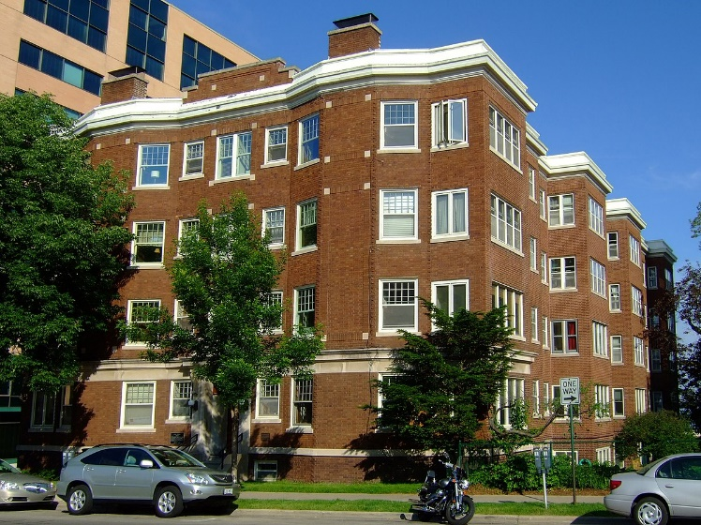
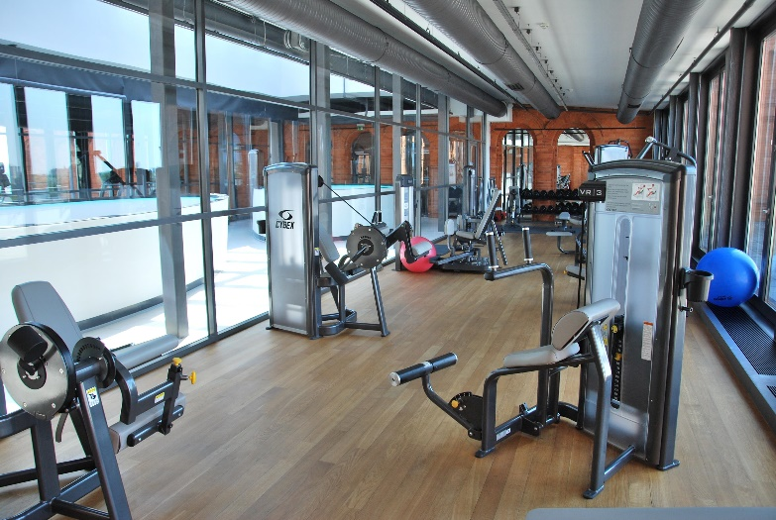
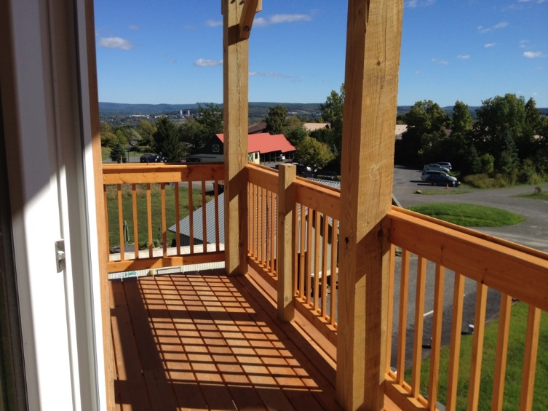
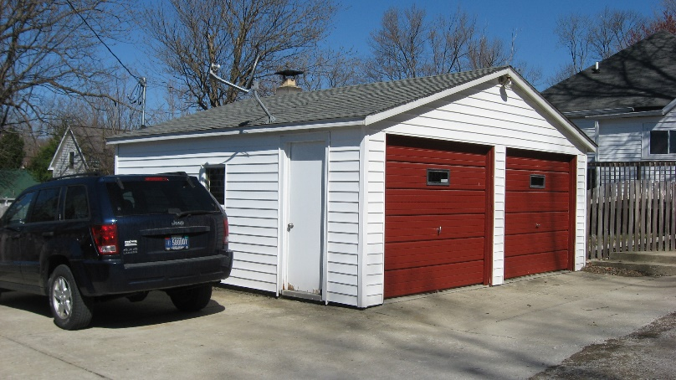
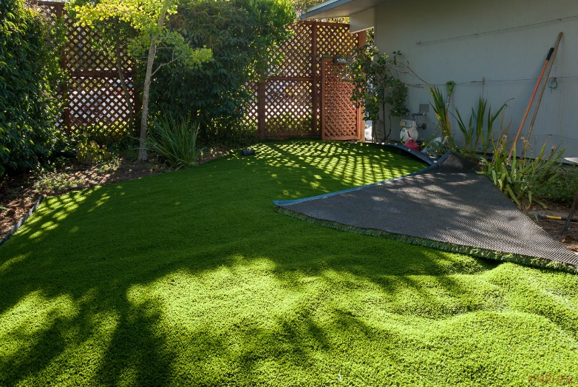
Listen , work in pair and number the picture.
1
6
5
2
3
4

Slide 13


basement
garage
My house
pool
Think about your house and draw smile face
or sad face.
yard
garden
Yêu cầu học sinh vẽ outline về căn nhà của mình. Ở mỗi từ giáo viên hỏi “ does your house have a basement? “ – Học sinh trả lời và vẽ mặt cười mặt mếu nếu nhà của mình có hay không có những nơi đó.
balcony

Slide 14
Using structure “ there is/there are” or “ have , has” write some sentences about your house and talk about it to your partner.
SPEAKING
Sample
Hello, my name is…………….
I want to talk about my house. I live in a house/an apartment. There is............ in my house. My house has………..
……………..
Example :
There is a big yard in my house
My apartment has a gym
Teacher asks students to practice and make a clip at home

Slide 15

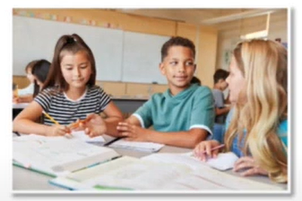

LISTENING
Listen to a girl asking a boy questions about his home and fill in the blank.
Are they friends?
Yes/no
The boy lives in __________________.
It has two ______________________
It has a small ____________________
It doesn’t have __________________
an apartment
bedrooms
pool
garage
Listen again and pay attention to the girl’s first sentence.
Để thu hút sự chút ý của người khác khi nói một cách lịch sự thường sử dụng “ Excuse me!”
Excuse me! Could I ask you some questions?

Slide 16
ROLE PLAY : PRACTICE THE CONVERSATION WITH YOUR PARTNER
Jenny: Excuse me. Could I ask you some questions?
Jim: Oh, you're in class 6A, aren't you?
Jenny: Yes, that's right. My name's Jenny. I'm doing a
survey for my geography class.
Jim: My name's Jim. What do you want to know?
Jenny: Thank you, Jim. Do you live in a house?
Jim: No, I don't. I live in an apartment.
Jenny: How many bedrooms does it have?
Jim: Two.
Jenny: Does it have a pool?
Jim: Yes, a small one.
Jenny: Does it have a garage?
Jim: No, it doesn't.
Jenny: Does it have a gym?
Jim: Yes, it does. There's a gym in the basement.
Jenny: Does it have a balcony?
Jim: Yes, it does. I can see the city from it.
Jenny: Great! Thank you for your help.
Jim: You're welcome.
Jenny: Goodbye.

Slide 17
WRAP -UP

Slide 18
Work in pair and practice the conversation
A: Do you live in a house?
B.…………………………………………
A. Is it big or small?
B. ……………………………………….
Does it have a garden?
………………………………………
A. Is there a balcony?
B. ……………………………………….
What thing do you like best?
…………………………………………………

Slide 19

Learn by heart new words.
Make a video clip to say something about your house.
Practice writing new word for ( word 1-6) on the writing sheet.

